Slide 1

Tytuł
ELEVEO
AXELERO REHA

Slide 2
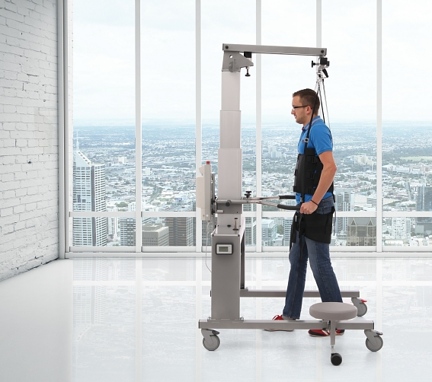
ELEVEO
ELEVEO
Tytuł
Systems for dynamic unloading

Slide 3
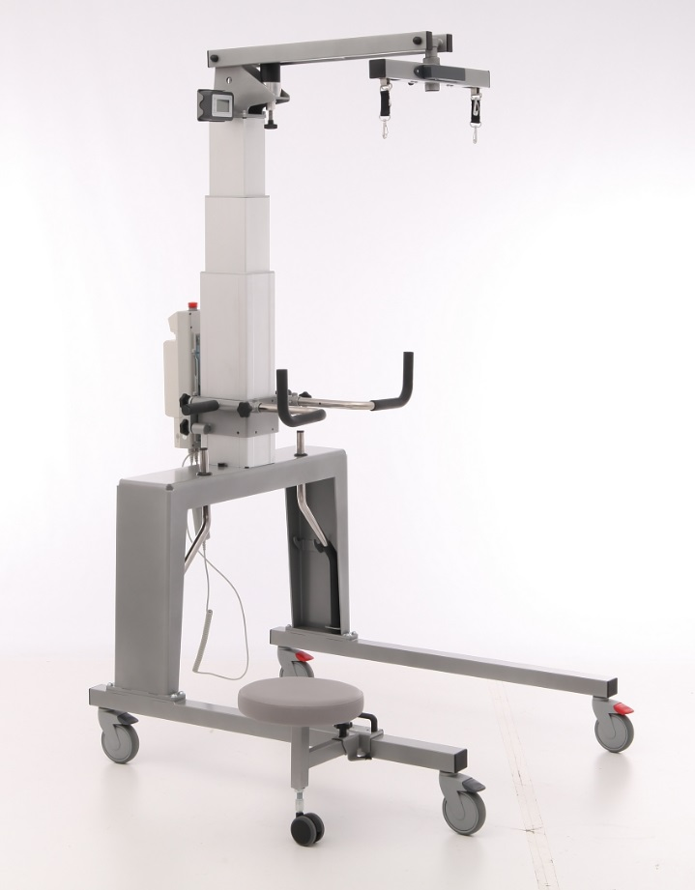
ELEVEO
ELEVEO is a device for simultaneous training of:
unloading
posture
balance
(on a treadmill or
firm surfaces)
Tytuł

Slide 4
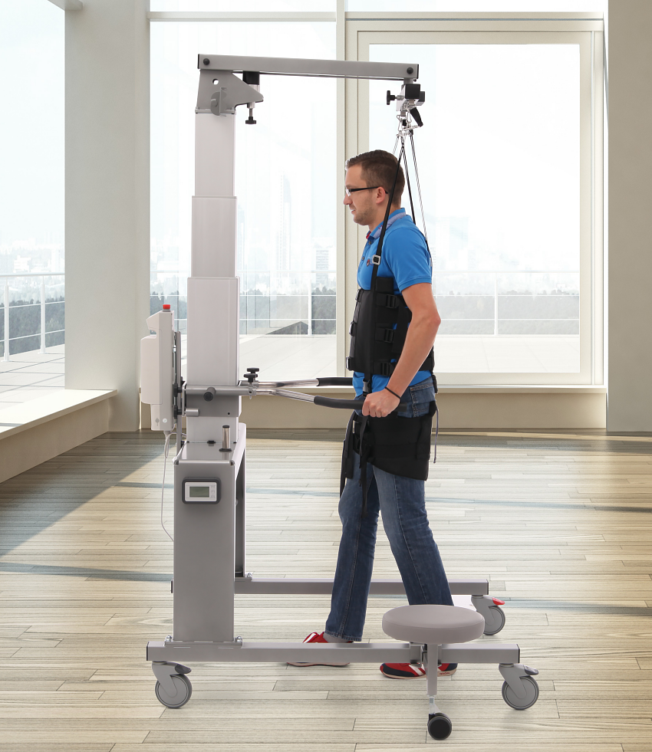
ELEVEO
stability
reliability
wireless
long lasting work of
weighing module
(on one charge session)
- max. 8 months
ease of use
intuitive switching on
(automatic, after detecting
the load)
Tytuł

Slide 5
ELEVEO
ELEVEO
used in:
  rehabilitation
  gait reeducation
used for:
  therapeutic purposes
  diagnostic purposes (training balance and gait)
ideal for working with:
  neurological patients
  orthopedic patients
  for adults and children
Tytuł

Slide 6
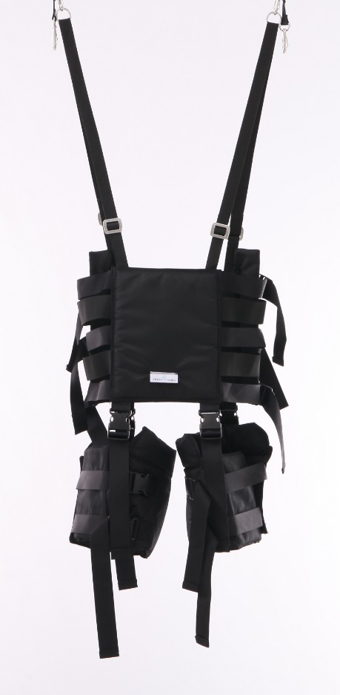
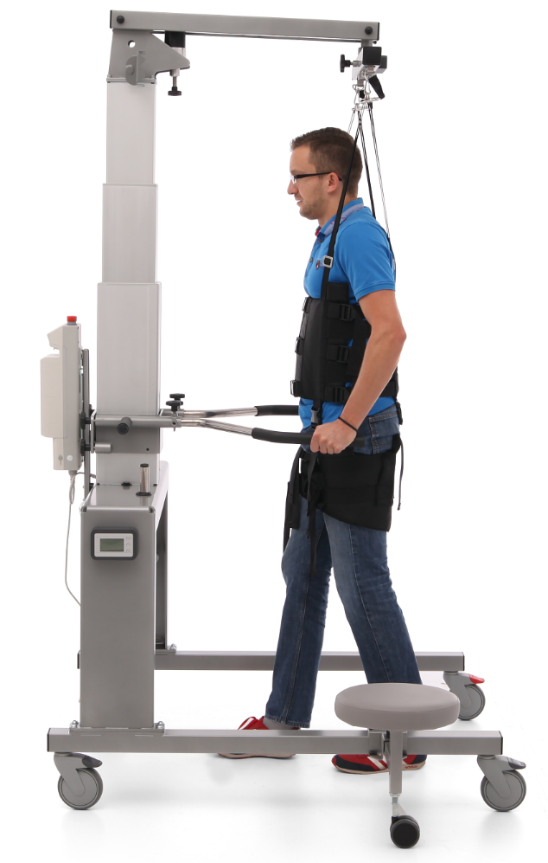
ELEVEO
ELEVEO
Tytuł
+
=

Slide 7


ELEVEO
ELEVEO:
Tytuł
Patient:
max. 160 kg
up to 210 cm
Height:
max. 234 cm
min. 164 cm
Width: 88 cm or 97 cm
Depth: 135 cm

Slide 8
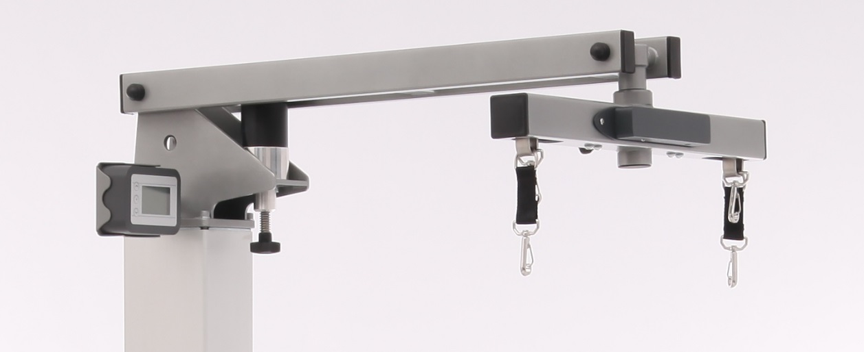
ELEVEO
ELEVEO – a dynamic partial weight bearing
system
weight bearing arm
weighing module
pulpit
Tytuł

Slide 9
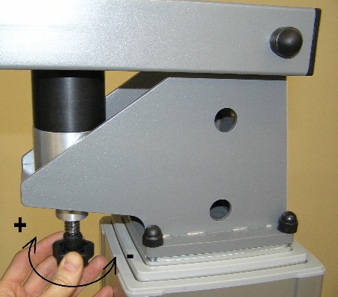
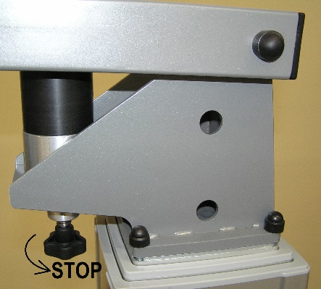
ELEVEO
ELEVEO – a weight bearing arm
dynamic lifting/lowering:
the range of 0-12,5 cm
adjusting dynamic
partial weight bearing
„+” , „-”
locking dynamic partial
weight bearing
„STOP”
Tytuł

Slide 10
ELEVEO
ELEVEO – a weighing module
1 - indicating LED
2 - reset buton
3 - charger socket
WeCoTRONIC – Weight Control ElecTRONIC system wireless weighting = transducers + radio transmission data;
electronic panel shows real-time data (weight, unloading) from BT-enabled tensometric sensors.
Tytuł

Slide 11
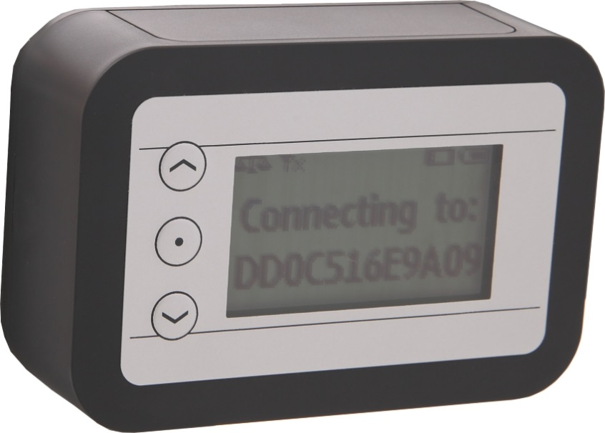
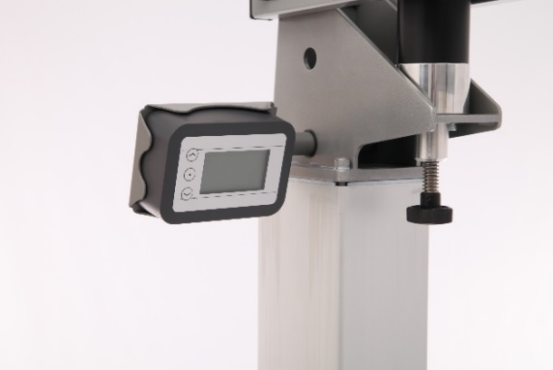
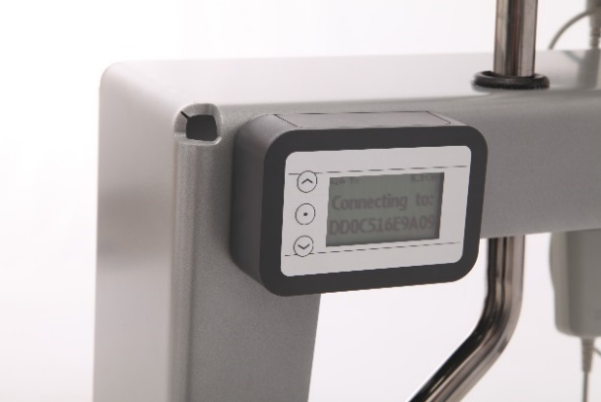
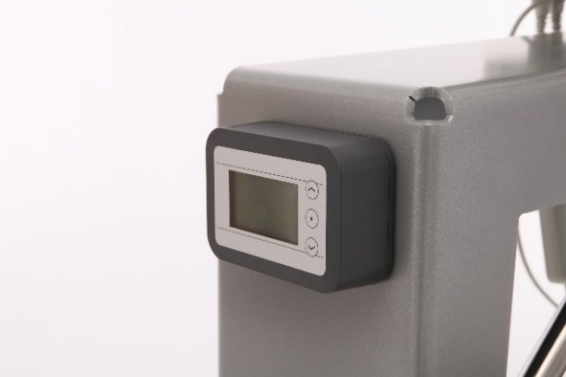
ELEVEO
ELEVEO pulpit
equipped with a screen
showing the degree of
weight bearing and
control buttons
movable and attached
magnetically in different places
Tytuł

Slide 12
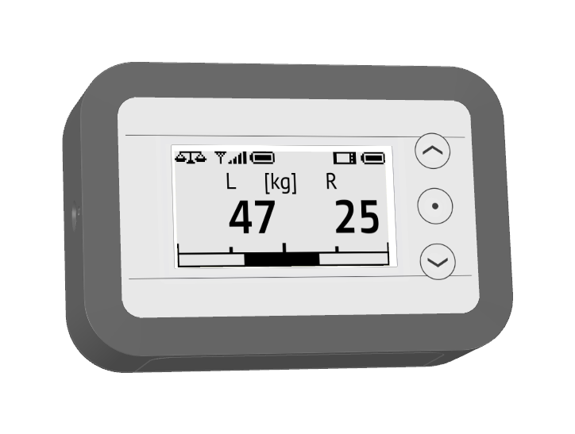
ELEVEO
ELEVEO – a pulpit
to activate – press any
buton and hold it for
more than 0,5 s
status bar (is always visible at
the top of the screen);
indicates the connection
status and battery level
of the weighing module and
operator panel
1 - charger socket; 2 - reset button
Tytuł

Slide 13





ELEVEO
ELEVEO – a pulpit – screen orientation
work with buttons on
the left or right side of
the screen (left and right
hand) or automatically
change the orientation
to change the orientation,
press the button
Tytuł

Slide 14
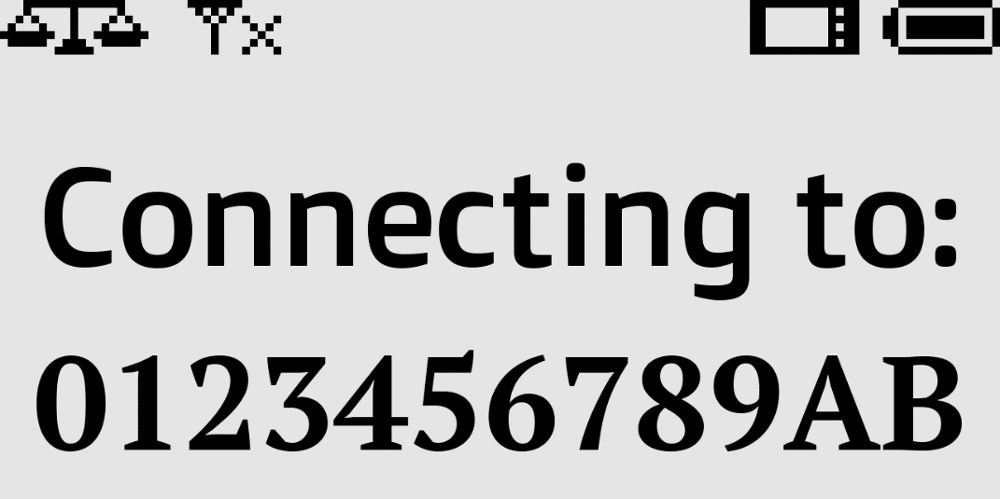
ELEVEO
ELEVEO – a pulpit - connection screen
When the panel is started, on a screen there is displayed information process of connection to a weighing module, which ID is displayed on the bottom line.
When connected
the main screen
is displayed.
Tytuł

Slide 15

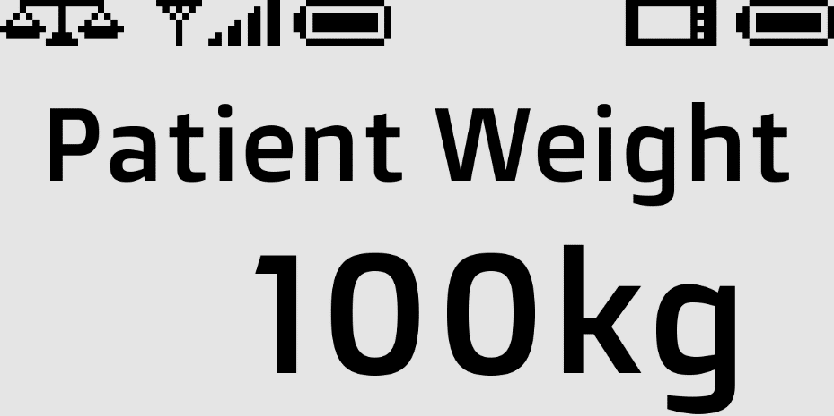


ELEVEO
ELEVEO – a pulpit - main screen
1 step –
MEASUREMENT RESET
to reset the display when
empty harness is mounted - without the patient ( button)
2 step –
INDICATION OF PATIENT WEIGHT ( button) to enter the weight of a patient by buttons and to set the desired value 25 to 200 kg
3 step –
WEIGHT RELIEF
MEASUREMENT
Tytuł

Slide 16
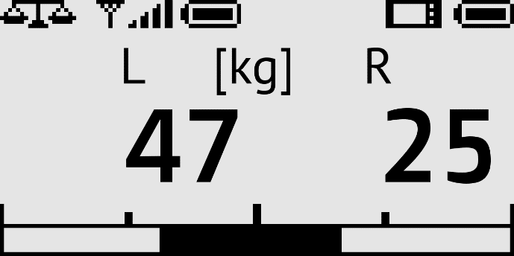
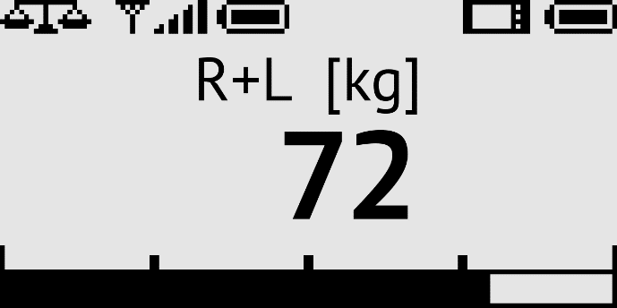
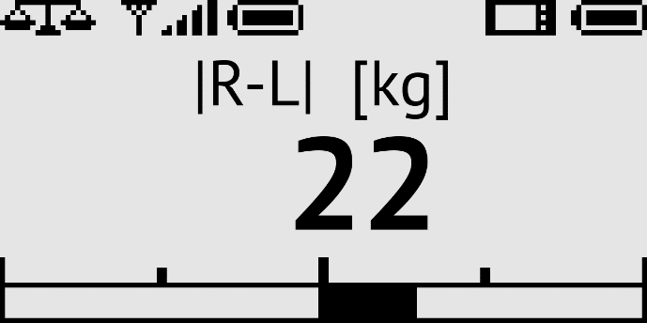
ELEVEO
ELEVEO pulpit - main screen
are displayed measured values of weight relief of left and right side;
graphic indicator shows the measured weight relief value relative to programmed patient's weight
dispalyed modes:
1 - indication for both sides L, R;
2 - indication for sum (R+L);
3 - indication for difference (R-L)
Tytuł

Slide 17
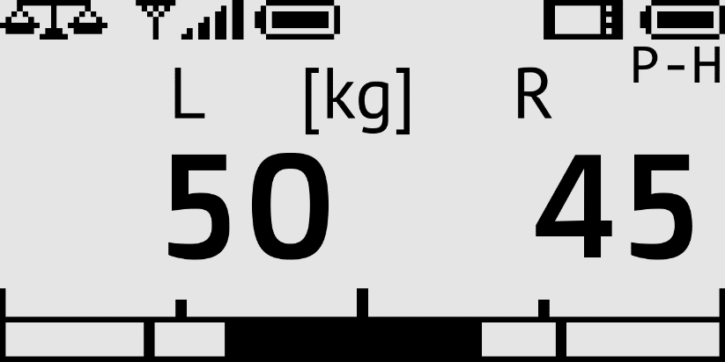

ELEVEO
ELEVEO pulpit – pick hold mode
MAINTAINING RELIEF PEAK VALUE –
pressing the button
will activate the peak relief hold
mode;
under the battery indicator of the
operator's panel is displayed
the symbol P-H;
this mode is active in all display
modes
when the Peak Hold mode
is activated, the display shows the
highest recorded relief shown within
the time set in the user settings

Slide 18
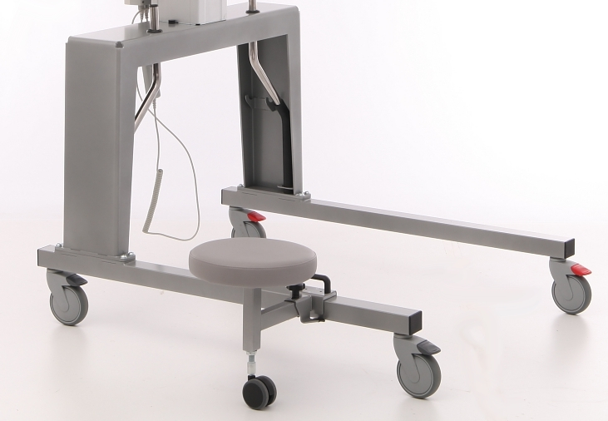
ELEVEO
ELEVEO – a wheeled base
equipped with four wheels with brakes,
base construction in wider version
allows free moving with treadmill,
with storing space for handrails,
with demountable upholstered
stool with the possibility of
moving the fixing position,
equipped with supporting
wheel.
Tytuł

Slide 19
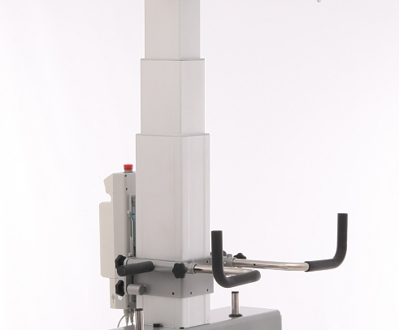
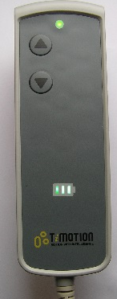
ELEVEO
ELEVEO – a lifting column
stable two-segment construction
controller with disconnected battery
electrical height adjustment
adjustable and interchangeable
rails for supporting the patient
during gait training
manual remote control
Tytuł

Slide 20
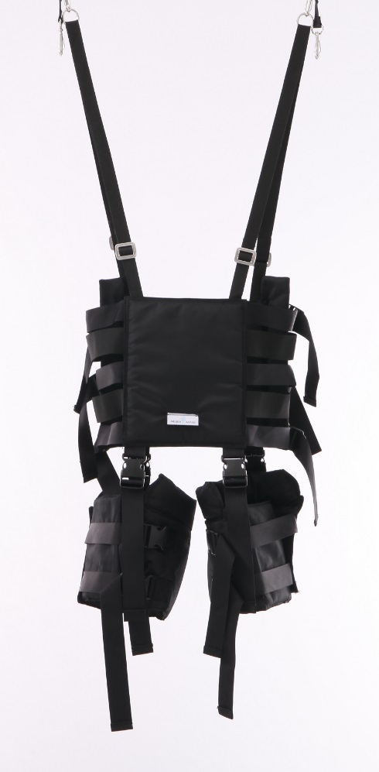
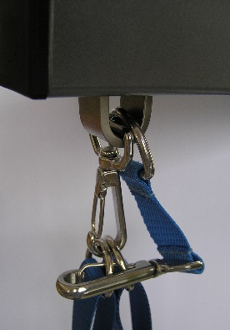
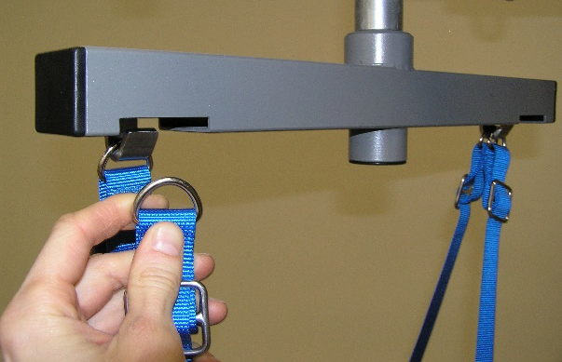
ELEVEO
ELEVEO – a harness for patient stabilization
universal size S-M-L-XL
easy cleaning - made from washable fabric
the harness is attached over patient’s head
by the lugs sewn into adjustable harness straps
suspension of the harness can be done directly
on the weight bearing arm (b) or on the swivel
sling (a)
Tytuł
additional safety hook
(a)
(b)

Slide 21
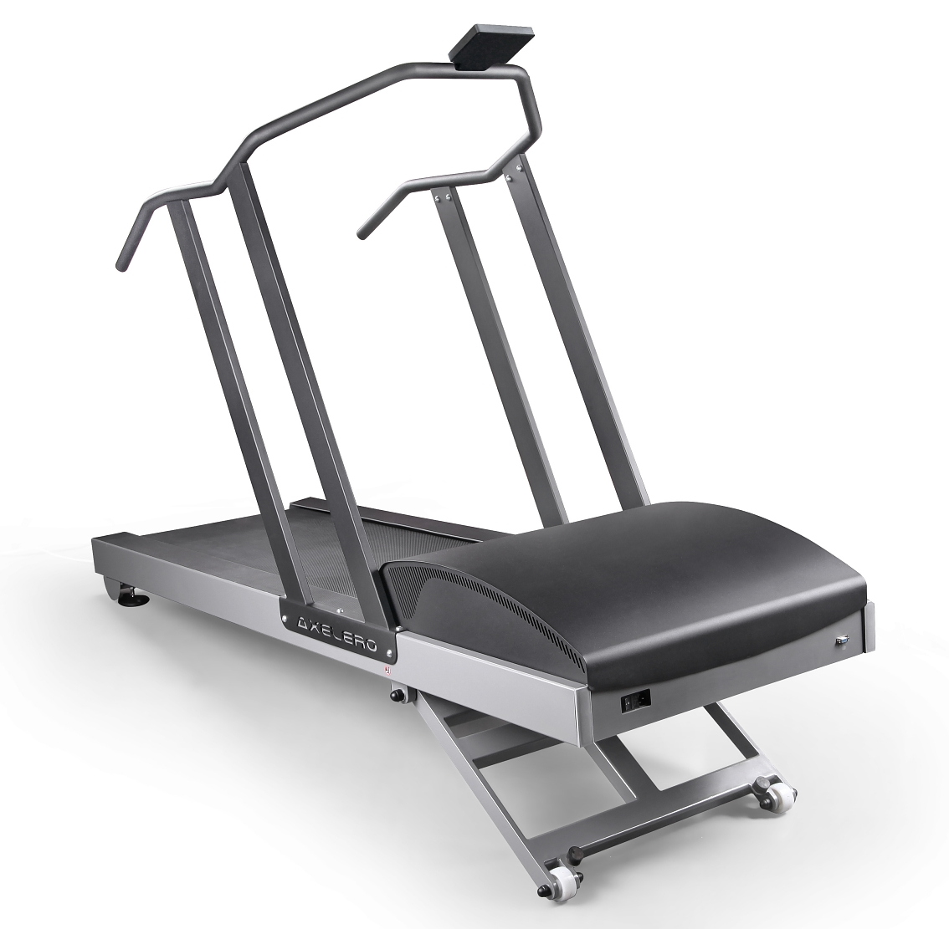
AXELERO
AXELERO
REHA
Tytuł

Slide 22
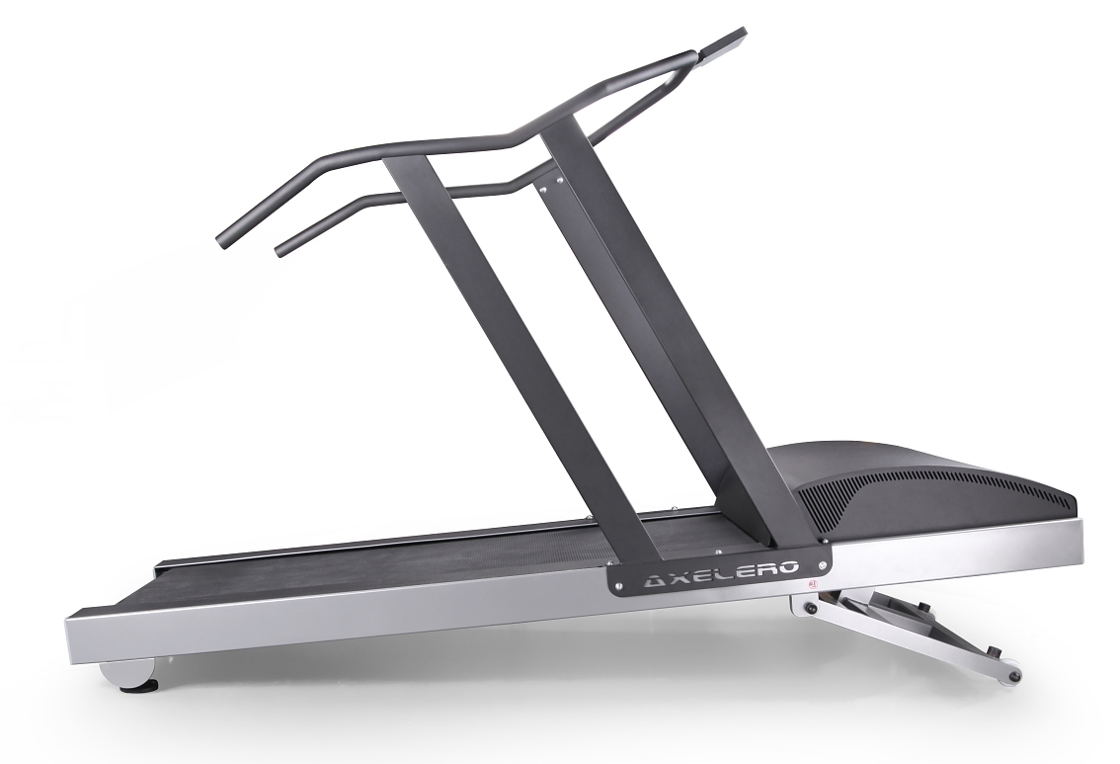
AXELERO
AXELERO REHA
a medical treadmill
designed for rehabilitation;
suitable for :
hospital and clinical use
in Physiotherapy;
Tytuł

Slide 23
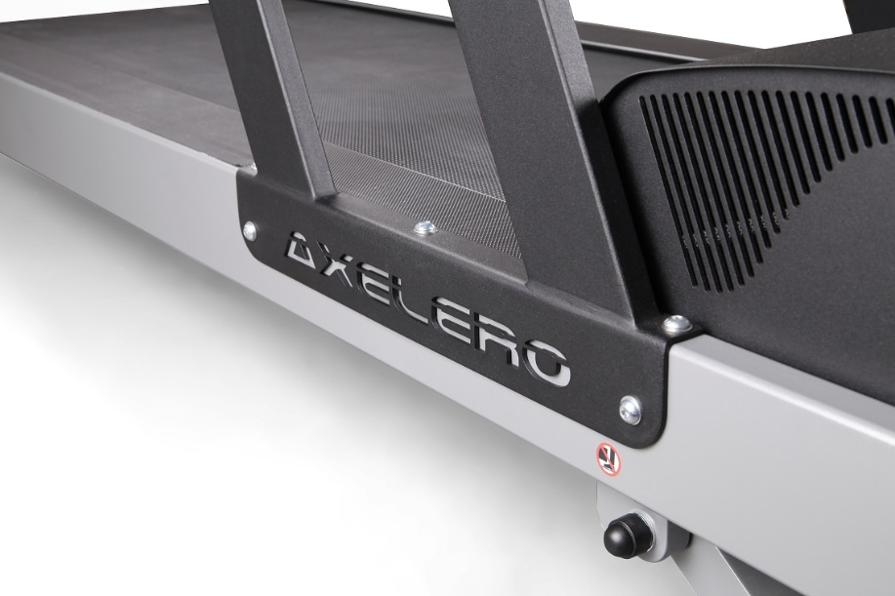
AXELERO
AXELERO ver. REHA – features:
system of gradual speed increase from 0,2 km/h to a preset value
belt speed range: 0,2 – 25 km/h
belt speed stabilization in the full drive load range
belt speed setting resolution: 0,1 km/h
belt elevation angle: 0-25%
belt elevation angle resolution: 0,5 %
lenght of the usable part of the belt: 140 cm
width of the usable part of the belt: 52 cm
smooth and quiet operation
easily accessible safety switch
which allows for switching
the device and the drive
off manually
control unit with color
LCD display
Tytuł

Slide 24
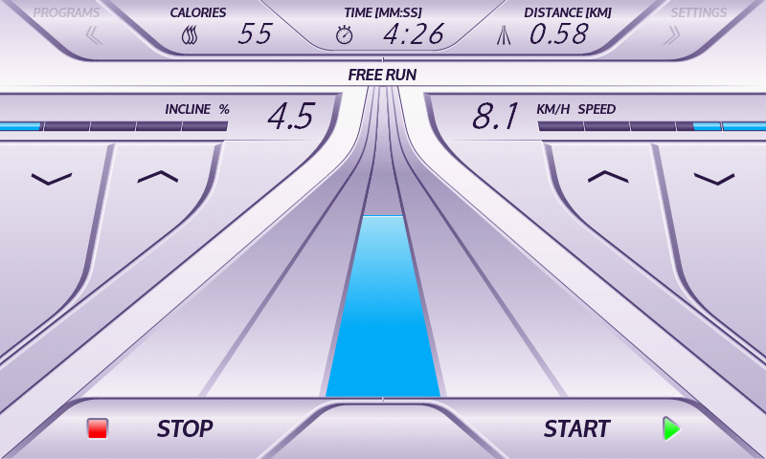
AXELERO
AXELERO ver. REHA – functions:
START/STOP
incline
speed
calories
distance
programs
Tytuł

Slide 25
AXELERO
AXELERO REHA – START/STOP:
button 'START' – it starts a 3-second
countdown to start the treadmill belt
at the speed of 0.2 km/h and with the
inclination of 0.0 %
is possible to modify the treadmill
belt speed and inclination set by
the user when the belt is in
motion
Button 'STOP' - has two functions:
  during the training session stops the belt, leveling it and going to pause
  (in case of exercise without a pause will end it);
  next pressing the „STOP” button for a stopped treadmill, will reset the
  recorded data (time, distance, burned calories) of the exercise and
  going to default values.

Slide 26
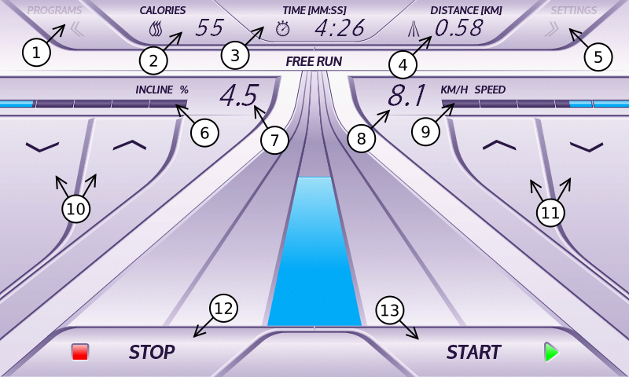
AXELERO
AXELERO REHA – main menu:
'PROGRAMS' button brings you to the screen of the program type
selecting (button inactive during exercise)
estimated value of calories burned during the exercise
value of performed exercise time
value of the distance defeated during the exercise
'SETTINGS' button brings you to the screen with
the treadmill settings
(button inactive during exercise)
strip visualizing the actual incline
of the treadmill
set up incline of the belt platform
set up belt speed
strip visualizing the actual belt speed
buttons used to adjust the belt incline
(buttons inactive when the belt is
stopped and for some programs)
buttons used to adjust the belt speed
(buttons inactive when the belt is
stopped and for some programs)
'STOP'
'START'

Slide 27
AXELERO
AXELERO REHA – programs:
'MANUAL PROGRAMS' –
possible to control speed and incline during the exercise
'DEFINED PROGRAMS' –
set up programs
'USER PROGRAMS' –
programs created by user

Slide 28
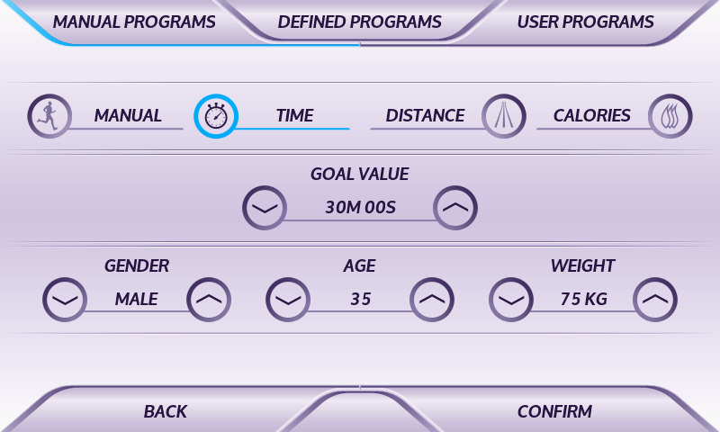
AXELERO
AXELERO REHA – manual program screen:

Slide 29
AXELERO
AXELERO REHA – manual program screen:
MANUAL – used to select
the exercise during which
the user controls all
parameters
TIME – used to select
the exercise with
a goal set up in
the form of specified
time after reaching which
the exercise ends
DISTANCE – used to select
an exercise with a goal set
up in the form of a specified
distance after reaching which
the exercise ends
CALORIES – used to select
an exercise with a goal set up
in the form of a specified calories
burned during exercise after reaching
which the exercise ends

Slide 30
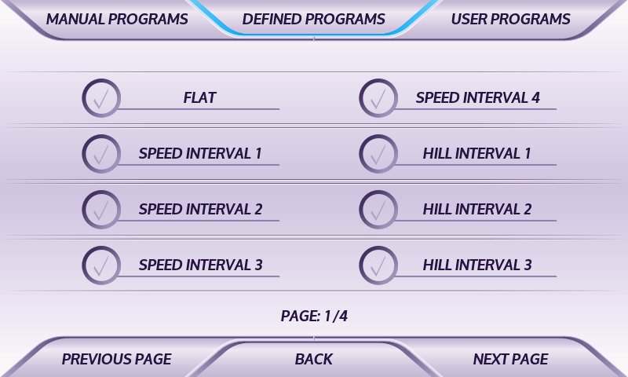
AXELERO
AXELERO REHA – list of defined programs:

Slide 31
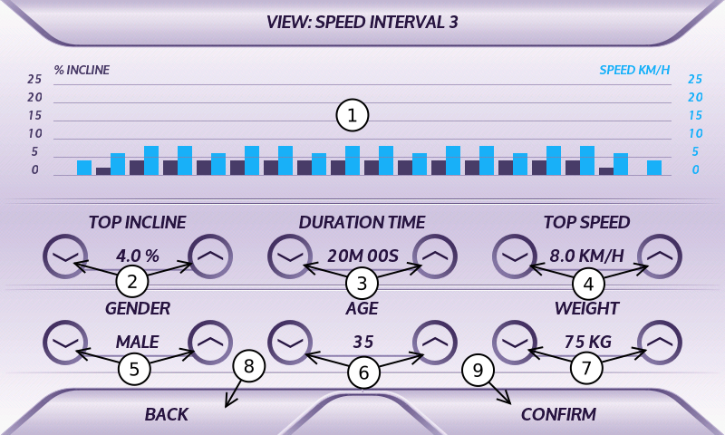
AXELERO
AXELERO REHA – defined program SPEED INTERVAL 3:
graphic preview
of the program
buttons to set up
the max. incline
buttons to set up the
duration of the exercise
buttons to set up
the max. speed
buttons to change
the sex of the user
buttons to change
the age of the user
buttons to change
the weight of the user
return to the program
list without making
changes in the current exercise
confirmation and going
to the main screen

Slide 32
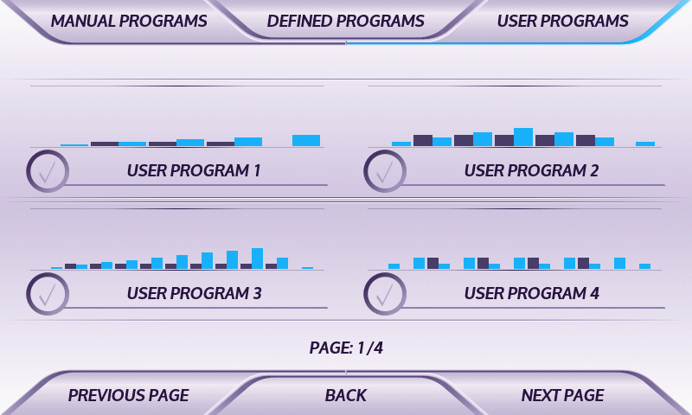
AXELERO
AXELERO REHA – list of user programs:

Slide 33
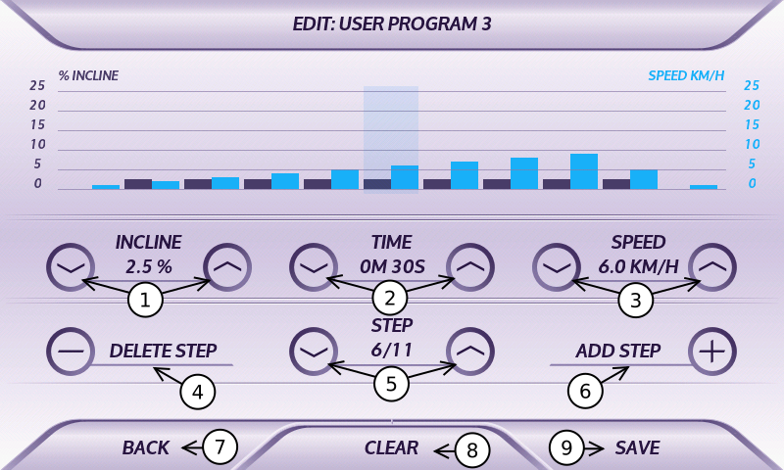
AXELERO
AXELERO REHA – user program USER PROGRAM 3 (edition):
buttons to set up
the incline of current step
buttons to set up the
duration of current step
buttons to set up the
speed of current step
button to delete
currently selected step
buttons used to move
between different steps
of the edited program
button to add a new step
of the edited program
back to the preview of the
edited program or to the
list of user programs
removing all steps
of the edited program
saving the program and switching to its preview or to list of programs

Slide 34
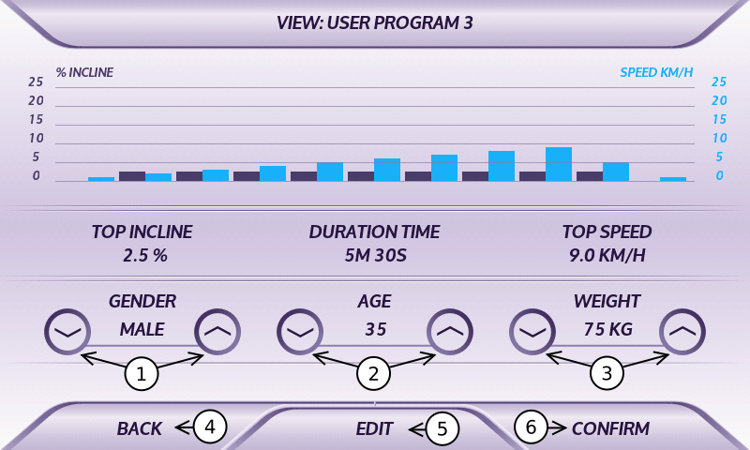
AXELERO
AXELERO REHA – user program USER PROGRAM 3 (view):
buttons to change
the sex of the user
buttons to change
the age of the user
buttons to change
the weight of the user
back to the list of user
programs (without
making changes)
going to the edition of
current user program
(edition secured
by code 2345
confirmation and going to the main screen

Slide 35
Thanks for your attention.

